Slide 1

Networking with Twitter
Sarah Jacobson @SarahJacobsonEc
Williams College
Academics & Social Media Forum #ASMFID, U VA, Nov 2019
I give permission for social media posts of my presentation,
including with photos of it and me.

Slide 2
Things I Have Gotten Out of Twitter (Professionally)
Connections with *AMAZING* people
Media contacts
Sharing my own work
Finding others’ work
Informal writing about data sets, methods, topics
Advice
Jobs for my students
Information on events, funding opportunities, etc.
Finding (more diverse) speakers for events
Conference live-tweets

Slide 3
I Plan to Talk to You About
Networking (Yuck)
Your Twitter Identity
Curating Your Twitter Network
Cultivating Connections
Promoting Yourself
Making Your Virtual Network Real
But I’m happy to discuss anything!

Slide 4
Networking, When It’s Gross, …
Is disingenuous
Serves only one’s-self
Ignores people who are not “useful”

Slide 5
Networking, When It’s Great, …
Shows genuine interest in others
Takes a long view
Expresses appreciation and admiration for others
Seeks mentoring, support, advice, and opportunities for self
Mentors and supports others
Helps others make connections

Slide 6
Not Networking… Building a Network.

Slide 7
Academic Twitter Networking Can Make Your Life Better. Why? How?
It’s where the academics are
Academic Twitter seems to be populated mostly by nice people
Broad reach to scholars with related or complementary interests
Share work in digestible snippets
You can curate your Twitter experience

Slide 8
Using Twitter for Non-Icky Networking
Get to know, and become known by, people in your discipline
Fancy people
Potential coauthors
People whose work you’ll love
People who will love your work
People you can help
Let people know what’s going on with you
Learn about or share opportunities (jobs, edited volumes, conferences, etc.)

Slide 9
Your Twitter Identity: You Get to Choose…
Your level of anonymity or privacy
Your desired mix of personal and professional

Slide 10
Aspects of Your Twitter Account that Can Reveal, or Not, Your Identity
Twitter handle (e.g., @SarahJacobsonEc) – fixed
Twitter display name (e.g., Sarah Jacobson) – changeable
Bio
Photo
Link to website

Slide 11
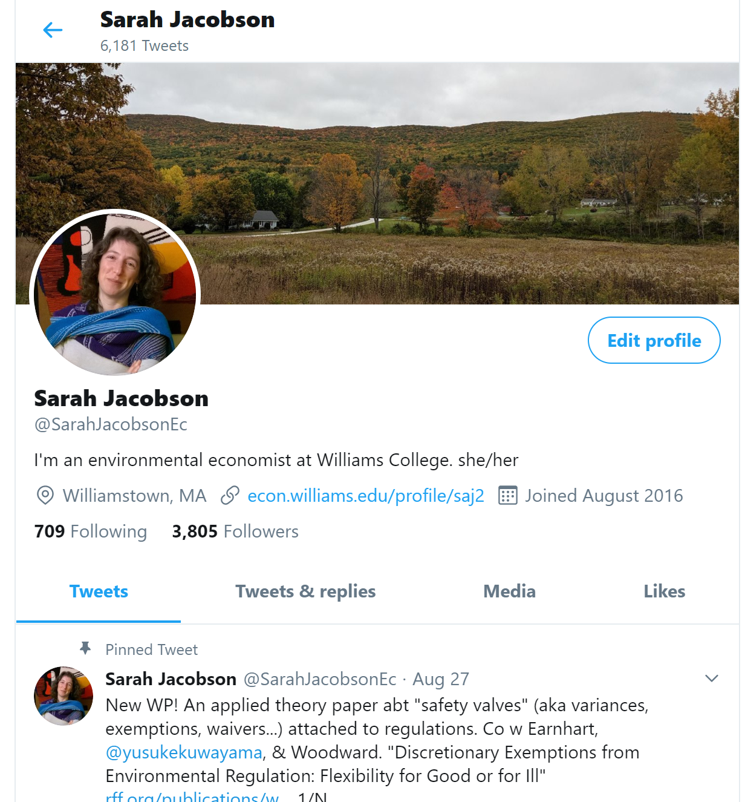
https://twitter.com/SarahJacobsonEc

Slide 12
Pros and Cons of Twitter Identifiability (Obvious, but Still…)
Pro: allows you to network
Con: leaves you vulnerable to bad actors
My perspective: academics are typically easily findable electronically, so our vulnerability isn’t really increased meaningfully
→ In which case, why not let all those elements identify you easily?

Slide 13
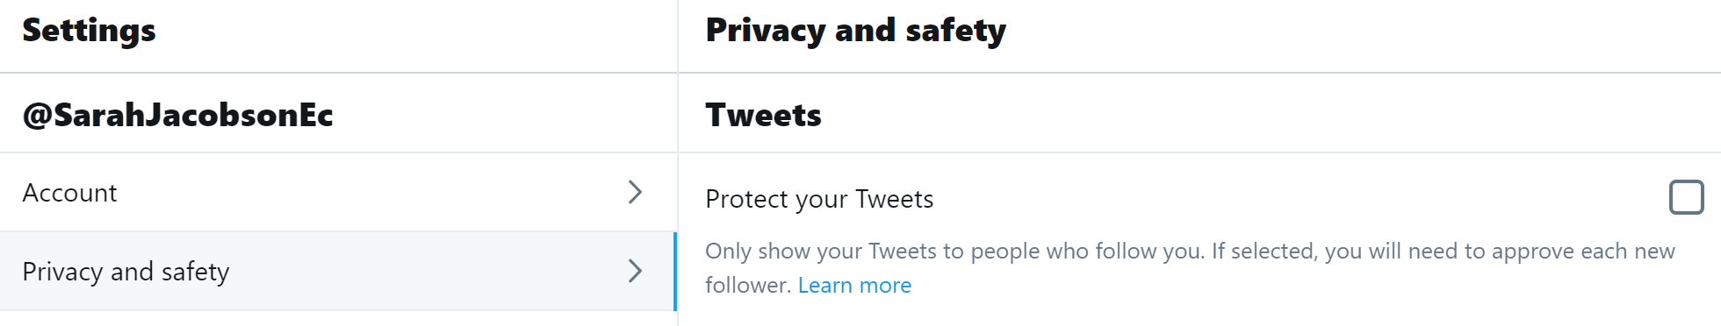
Protecting Tweets
People can see your account but not your Tweets until you approve them as followers
Relatively rarely used, but an option if you’re concerned

Slide 14
Safety for People Concerned about Targeting
People who might be targets of hate have special concerns on Twitter
E.g. Women, people of color, intersectional groups
Blocking obnoxious accounts protects you from their in-Twitter harassment
More accounts can be made, and it’s possible for harassment to shift offline
You might not want to post that you’re traveling / where you’re traveling, or location-tag tweets
I never location-tag my tweets
If you’re very worried, a high profile social media existence might not be right for you
(To be clear, nothing bad has happened to me yet)

Slide 15
The Personal vs the Professional: Alternative Models
Let it all hang out
Professional only
Personal only
(Obviously not as useful for networking)
Separate professional and personal accounts
(Personal account may or may not be rendered hard to link to identity)
Be guided by your personal comfort and goals

Slide 16
Curating Your Twitter Network
Populate your timeline with things that enrich you, personally or professionally
Post and retweet the kind of things you’d like to see more of

Slide 17
Curation Through Following
Choose your follows so that when you scroll, you often say,
“Ooh, interesting!”
and rarely say,
“Ugh!”
You can also use Lists and meta-apps like TweetDeck to make your Twitter feed more manageable
(I don’t use these, and as a result, I don’t follow high-volume Tweeters)

Slide 18
You Attract What You Put Into the World
The kind of people who engage with you are attracted by your actions on and off of Twitter
The ways they mention, reply to, and retweet you will reflect your actions back at you
Twitter Golden Rule?

Slide 19
Cultivate Connections Through:
Your tweets
→ Others’ retweets of you
Your engagement with others’ tweets

Slide 20
Tweeting Things of Value (Which Will Eventually Attract Followers)
Share novel things
E.g., don’t RT NY Times or WaPo articles unless you’re adding some insights
Take some (but not too much) care with composition & typos
Edit Tweet threads for concision and clarity and brevity
Tweet regularly, but not random nonsense (unless it’s really funny)
A couple a day?
Provide public services
Support other people
Use retweets-with-comments to position yourself

Slide 21
It’s Hard to Know What Will Take Off, But I Think People Like…
Positive tone (no meanness or sniping)
An honest experience or feeling that resonates
Images (e.g. graphs and other figures)
Brevity
Something fun (including a lot of GIF’s)

Slide 22
But I Have Pearls of Scathing Wit to Dispense!
Complaints can be popular…
… but can come back to bite you…
… your students, colleagues, referees, & family may be on Twitter…

Slide 23
Hashtags and Mentions
Use hashtag # (a.k.a. octothorpe) so random others will stumble on your tweet
E.g. #ASMFID
I haven’t had a lot of exposure this way, but still worth trying
Mention someone by including their handle in a tweet
They’ll get a notification
They may respond, retweet, etc.! Even if they’re fancy people!
This can amplify you to their followers

Slide 24
Conference Live-Tweeting
Public service: share with others interesting stuff you’re seeing
Use conference hashtag; if organizer hasn’t made one, ask!
Mention (@) the presenter – & note if they are on the job market!
Norms on Tweeting photos of presenter & slides are not settled
I always ask unless the presenter gave explicit permission or it’s a keynote
Different levels of detail
I prefer one tweet per presentation
Others do more, or less
Group selfies outside of the official sessions

Slide 25
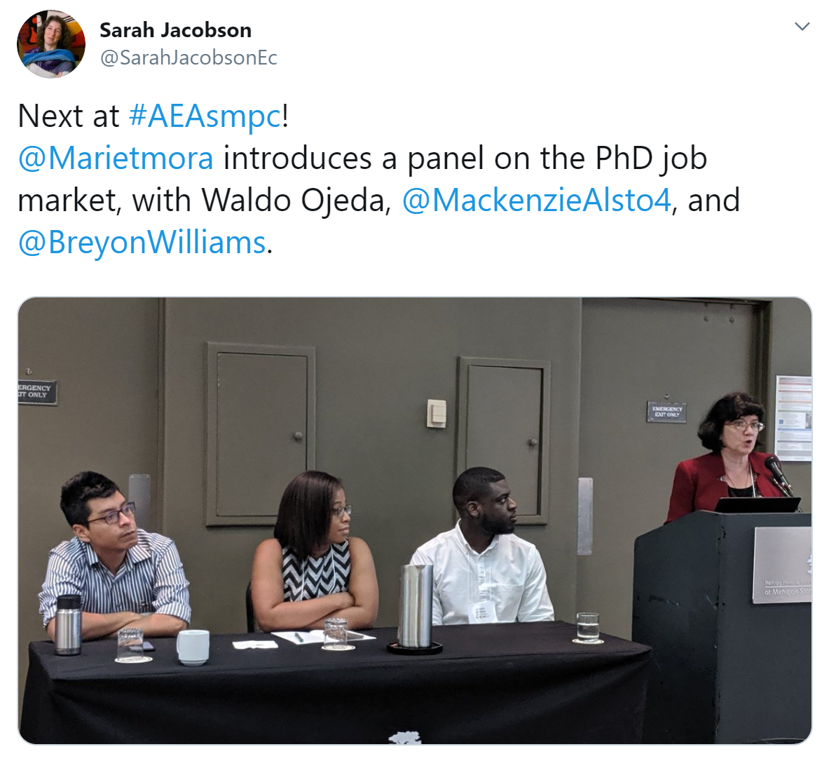
https://twitter.com/SarahJacobsonEc/status/1155121243768705024

Slide 26
Make Useful Threads
Professional advice
Call out important issues
Describe a useful methodology, important topic, or interesting paper

Slide 27
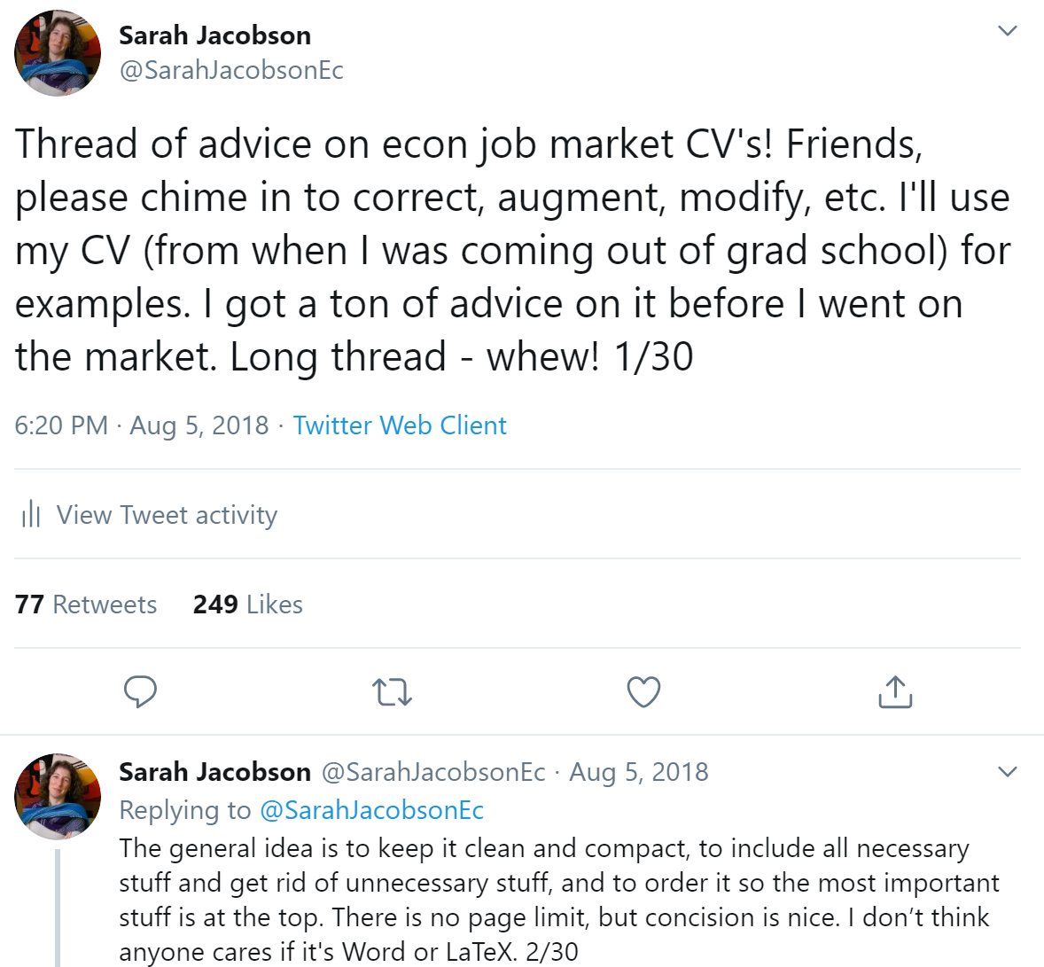
https://twitter.com/SarahJacobsonEc/status/1026231483638460417?s=20

Slide 28
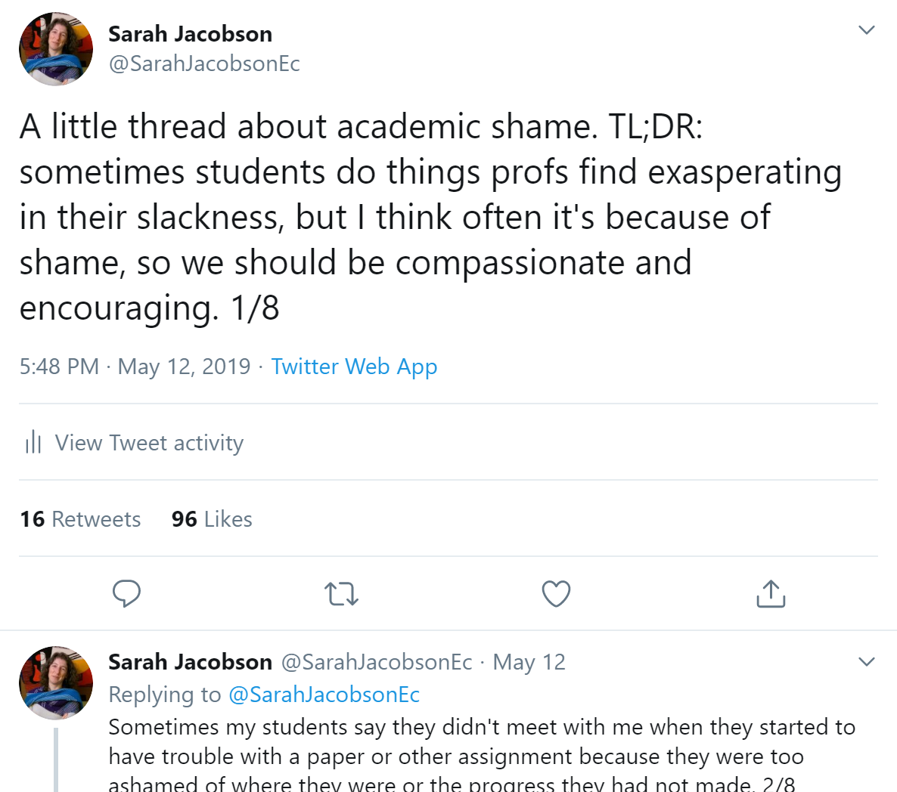
https://twitter.com/SarahJacobsonEc/status/1127692026584227840?s=20

Slide 29
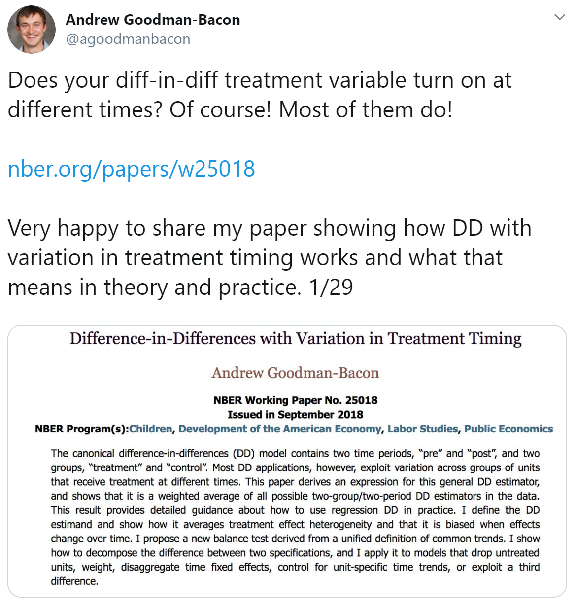
https://twitter.com/agoodmanbacon/status/1039126592604303360?s=20

Slide 30

How Engaging with Others’ Tweets Can Help Cultivate Connections
Reply to a person’s tweets
Their followers only see if they dig into the thread, or if the person RT’s
Quote-tweet a person’s tweets
Their followers only see if the person RT’s

Slide 31
Making Media Connections (I know very little about this, but it’s a thing)
Reach out to (DM) reporters or podcasters
Tell them about your work, or how it relates to a current event
Discuss an issue in your field
If you’re regularly tweeting stuff they may be interested in, relevant reporters will start to follow you
Original stuff about your & others’ research
Commentary on current events based on your expertise

Slide 32
Leveraging Other Outlets to Connect with the Media
Your institution’s media relations dept → press releases, website features, etc.
Academic engagement outlets like The Conversation, EconoFact
Blogs or websites in your field like env-econ.net, rff.org

Slide 33
But I Don’t Know Enough to Talk to the Media…
Yes, you do.
You are not an imposter.
You know way more than lots of people on TV/radio.

Slide 34
Building Connections Takes Time
Don’t constantly stress out about how fast or slow your number of followers is growing, or how many likes a tweet gets.

Slide 35
Promoting Yourself
Make yourself Twitter-discoverable
Make sure your Twitter bio links to your website
Tweet-thread new working paper or publication
Announce yourself as a job market candidate
Brag about accomplishments, like grants, awards, jobs

Slide 36

https://twitter.com/SarahJacobsonEc/status/1166537971216080896?s=20

Slide 37
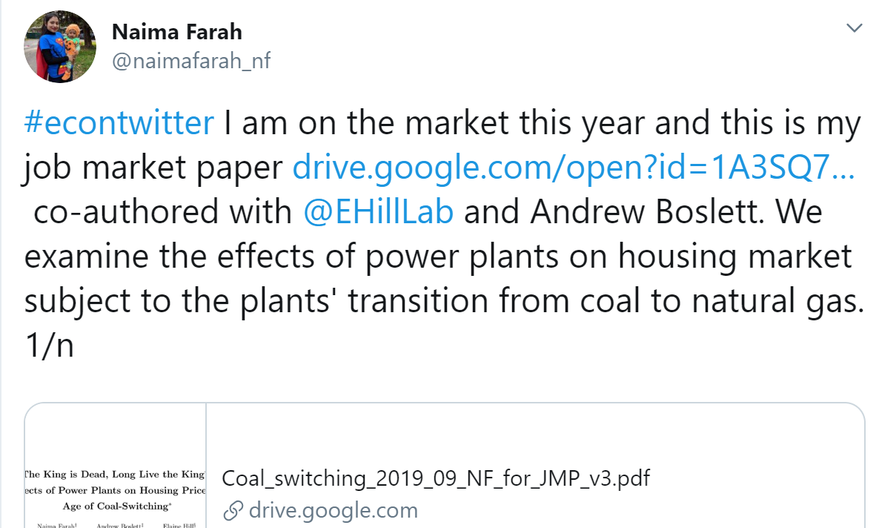
https://twitter.com/naimafarah_nf/status/1184850548803166208?s=20

Slide 38
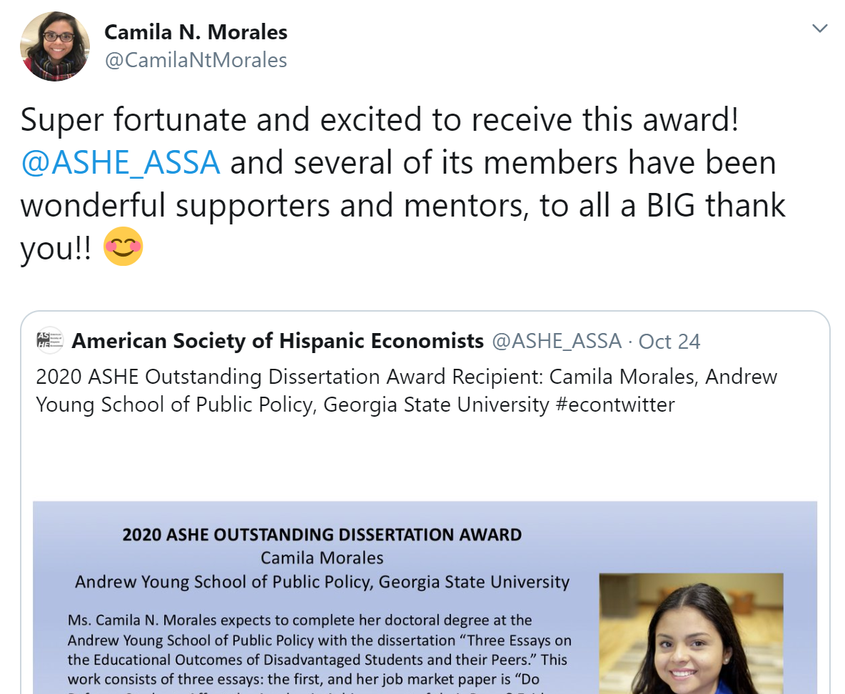
https://twitter.com/CamilaNtMorales/status/1187480327016435712?s=20

Slide 39
Take TwitterBuddyships Offline!
Organize or attend Twitter conference meetups
Introduce yourself to academic Twitter heroes/pals when you see them in the wild
Don’t be shy! These people put themselves out there.
When traveling, see who in the Twitterverse wants to meet up
Broadcast: “Hey, #EconTwitter, I’m in Charlottesville for a day with free time Tue evening… anyone want to get a drink?”
DM or email individuals

Slide 40
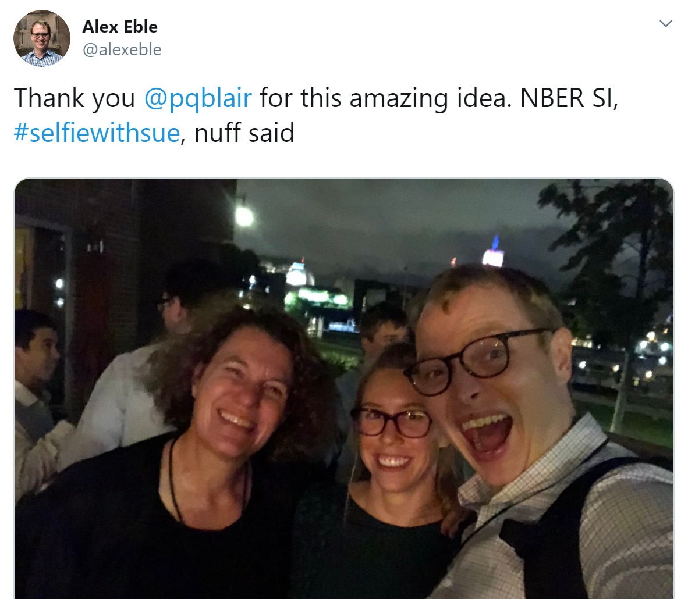
https://twitter.com/search?q=%23selfiewithsue&src=typed_query

Slide 41
Closing Thoughts
Networking can stress you out or feel icky
Real networks give you resources, let you help others, ground you, celebrate your successes, support you through difficult times
Twitter is a new(ish) way to do this that’s nice because:
Connects people who may be isolated (in terms of location, field of study, demographics, etc.)
Is populated by lots of academics
And most of them seem to be really nice
Engage as your authentic self, and be ready to ask for & receive help

